Slide 1

Quantifying the effect of ICME removal and observation age on in-situ solar wind data assimilation
Harriet Turner, Mathew Owens, Matthew Lang, Siegfried Gonzi and Pete Riley
22nd April 2022

Slide 2
Solar wind and data assimilation
Observations
Data assimilation (DA) combines model output and observations to form an optimum estimation of reality
Led to large improvements in terrestrial weather forecasting
Under used in space weather forecasting
Model output
Data assimilation
Optimal state of the system
Forecast
H. Turner
h.turner3@pgr.reading.ac.uk
RAS
Notes:
My whole PhD project focusses around the improvements that data assimilation (DA) can provide to space weather forecasting. DA combines prior knowledge about a system, typically from a numerical model, with observations to form an optimum estimation of reality, known as the posterior. It has led to large improvements in terrestrial weather forecasting but is yet to be fully utilised in solar wind forecasting. However, initial experiments into using DA for solar wind forecasting has shown potential for improvement in forecast skill.
DA vs ML – DA has the prior knowledge and the system physics whereas ML does not

Slide 3
BRaVDA scheme
Burger Radius Variational Data Assimilation scheme (Lang and Owens, 2019)
Uses solar wind propagation model and observations from STEREO spacecraft and OMNI dataset
3 sources of observations
Spacecraft observations can be assimilated together or individually
Reconstructs solar wind in 27-day windows from 30 to 215 R_{s}
H. Turner
h.turner3@pgr.reading.ac.uk
RAS
Notes:
I have been using the Burger Radius Variational Data Assimilation, or BRaVDA, scheme developed by Matt Lang. BRaVDA makes use of in situ observations of near-Earth solar wind conditions from the OMNI dataset and distant observations from the STEREO mission, thus providing 3 sources of observations to assimilate. These observations can be assimilated together, individually or in any combination. BRaVDA reconstructs the solar wind in 27-day windows, i.e. a full solar rotation, from 30 solar radii to Earth and as it is initialised on a daily cadence, we essentially get a new posterior for everyday in the analysis period.

Slide 4
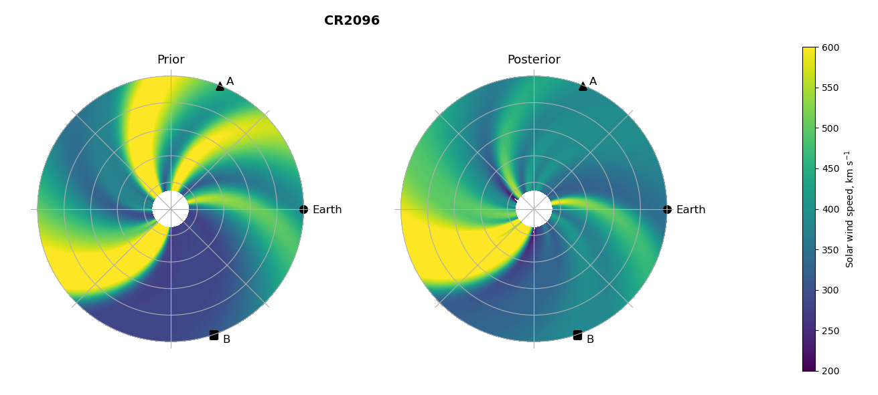
Effect of DA
H. Turner
h.turner3@pgr.reading.ac.uk
RAS
Notes:
This shows an example of what the DA does to the prior information. The prior is taken from an ensemble of initial conditions, and this shows the view looking down on the ecliptic plane. We have observation sources from STEREO-A and B and from OMNI for near-Earth. You can see that once the DA is performed, the velocity of certain streams are updated to reflect the observations from the spacecraft.

Slide 5
Solar wind forecasts from BRaVDA
Using the 27-day reconstruction, this can be used to forecast the next 27 days
Forecasts for Earth, STEREO-A and STEREO-B
t₀₋₂₇
t₀
t₂₇
Assimilation window
Forecast window
DA output
Solar wind speed
Forecast
t
H. Turner
h.turner3@pgr.reading.ac.uk
RAS
Notes:
With the output from BRaVDA, we can construct a forecast using corotation. If we assimilate the previous 27 days worth of observations, this can be projected forwards and used to forecast the next 27 days at Earth, STEREO-A or STEREO-B. As BRaVDA is initialised on a daily cadence, this means we can build up a forecast time series for a specific lead time. The forecasts can then be compared against the observations and we can analyse their performance by looking at the mean absolute error.

Slide 6
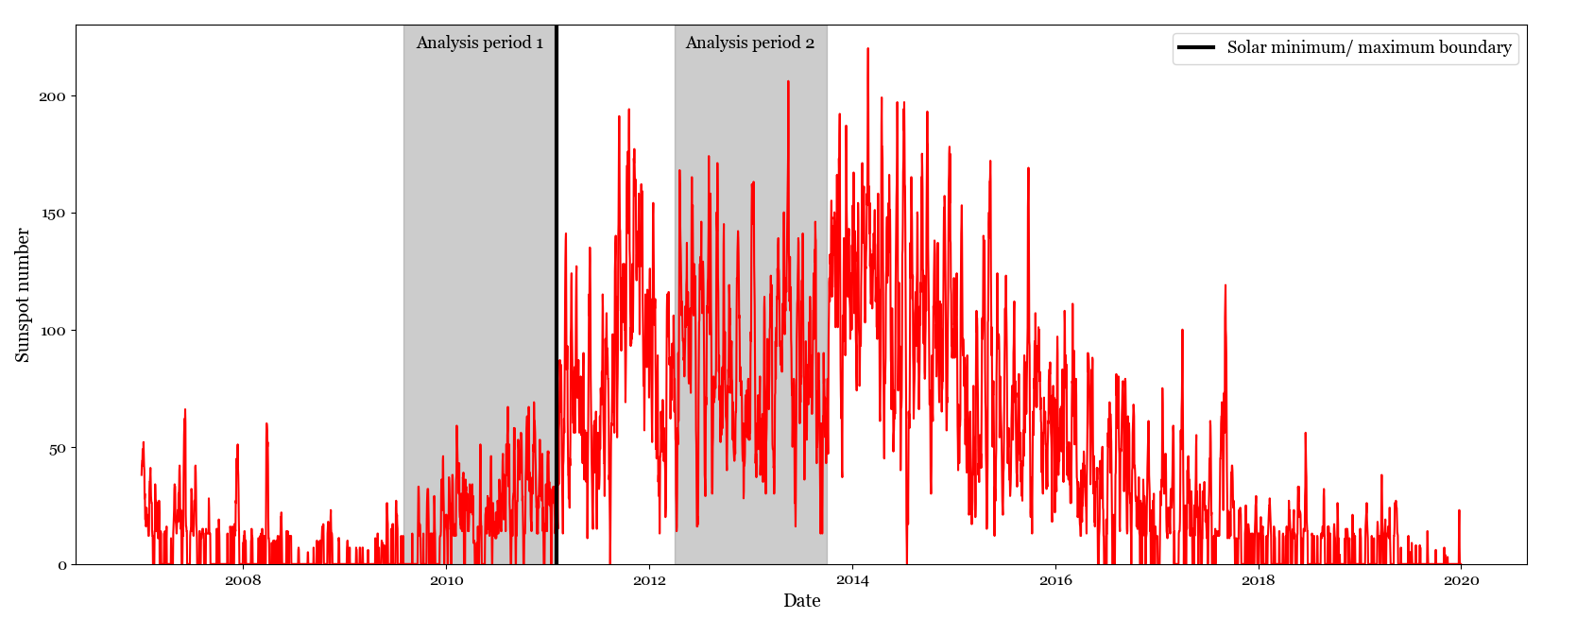
Analysis periods
Two analysis periods – solar minimum and solar maximum
H. Turner
h.turner3@pgr.reading.ac.uk
RAS
Notes:
I have looked at two analysis periods, one in the 18-months up to the boundary between solar minimum and maximum from 1st August 2009 to 1st February 2011 and one in solar maximum from 1st April 2012 to 1st October 2013.

Slide 7
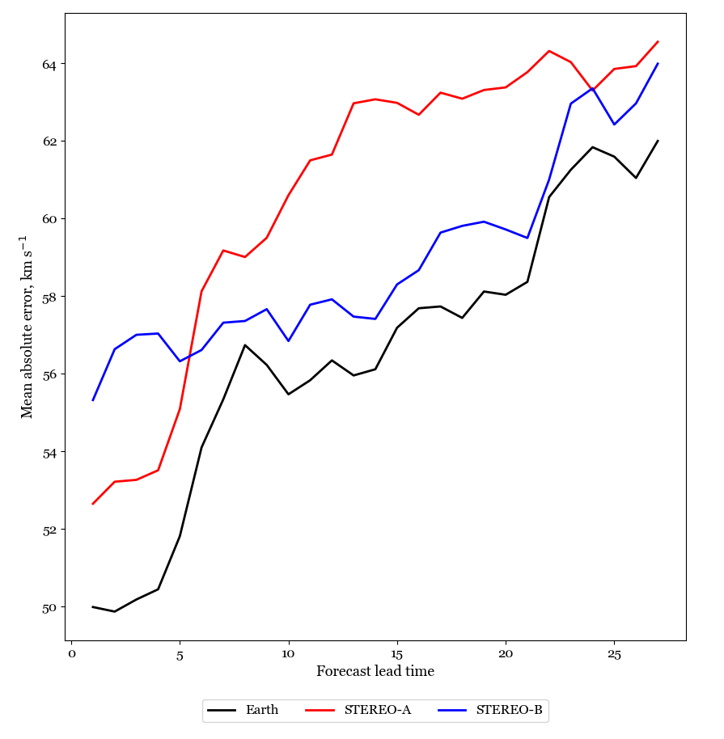
Forecast error against lead time
Error generally increases with lead time
Longer lead time forecasts are worse, which would be expected
H. Turner
h.turner3@pgr.reading.ac.uk
RAS
Notes:
Looking at the variation of MAE with lead time, we can see that there is a general trend for increasing MAE with lead time. This is true for forecasts at all three spacecraft locations, and this example shows when all three spacecraft observations were assimilated.

Slide 8
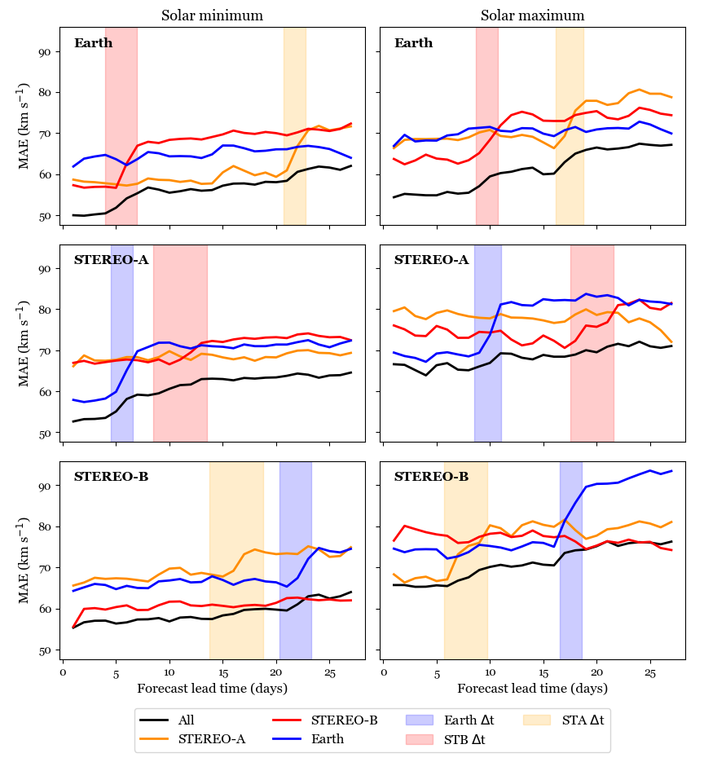
Age of observations
Increase in error when forecast lead time exceeds corotation time
Assimilation of individual spacecraft
Due to age of observations
Almost always, better to assimilate multiple spacecraft than single spacecraft
H. Turner
h.turner3@pgr.reading.ac.uk
RAS
Notes:
I performed experiments using BRaVDA to see the impact of assimilating individual spacecraft observations compared to when all observations are assimilated. This plot shows the MAE variation with lead time for these experiments, with all observations assimilated in black, STEREO-A in orange, STEREO-B in red and Earth or OMNI in blue. The most obvious trend is that it is almost always better to assimilate multiple observations than individual observations, as the black line shows the lowest MAE. Overall there is a general trend for increasing MAE with lead time, and when all spacecraft observations are assimilated, this increase is fairly smooth. However, when individual spacecraft are assimilated, there are clear step changes in the MAE. Once the lead time exceeds the corotation time (or the time it takes the Sun to rotate between two objects) between the assimilated spacecraft and the forecast location, we see this increase in MAE, as shown by the shaded regions.

Slide 9
ICME removal
BRaVDA has no knowledge of ICMEs, so observations are treated as the steady-state solar wind
ICMEs could produce false streams in the solar wind reconstruction or false alarms in the forecast
Removed from the DA input time series and linearly interpolated over
H. Turner
h.turner3@pgr.reading.ac.uk
RAS
Notes:
I also performed experiments with removing ICMEs using BRaVDA. The DA scheme has no knowledge of ICMEs, so if an ICME is observed at one of the spacecraft, this would be interpreted by BRaVDA as a fast solar wind stream. This would then be visible in the reconstructed solar wind and could produce a false fast stream and therefore a false alarm in the solar wind forecast. It was theorised that by removing the ICMEs from the DA input observations and the verification time series that the forecasts are compared against, there could be a reduction in forecast MAE through removal of the false streams. I used the HELCATS ICME catalogue and removed the observations between the start and end time of the ICMEs plus 24 hours either side. I then linearly interpolated over the resulting data gap.

Slide 10
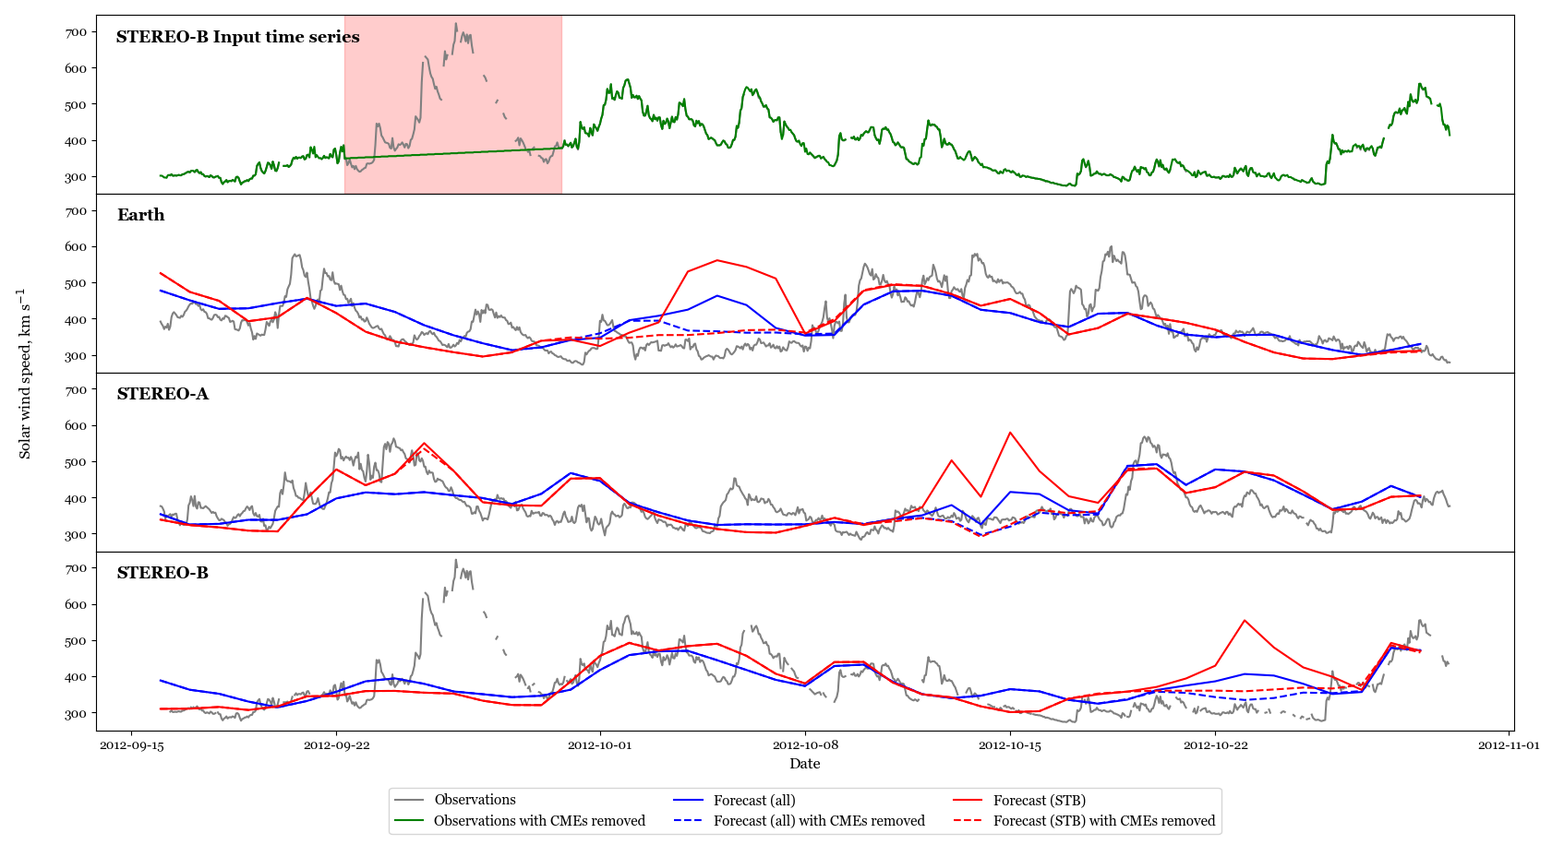
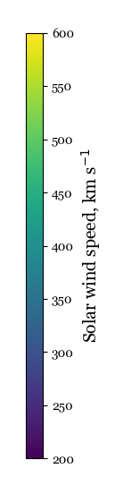
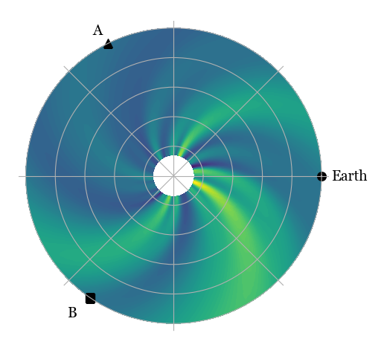
ICME removal
H. Turner
h.turner3@pgr.reading.ac.uk
RAS
Notes:
This is an example of removing just a single ICME from the DA input observations. This was a fast ICME that was observed at STEREO-B, as you can see in grey, which I then removed from the time series, in green. The coloured lines show the 5 day forecasts, with the blue line showing when all three spacecraft observations are assimilated and the red line when only STEREO-B observations are assimilated. The solid line shows when the ICME remains in the input and the dashed line when the ICME is removed. We can see that in both cases, removing the ICME reduces the amplitude of the fast stream in the forecast at all three locations, bringing it closer to the observations in grey. We can also see the benefit of assimilating multiple observations, as the blue solid line is considerably lower than the red solid line.

Slide 11
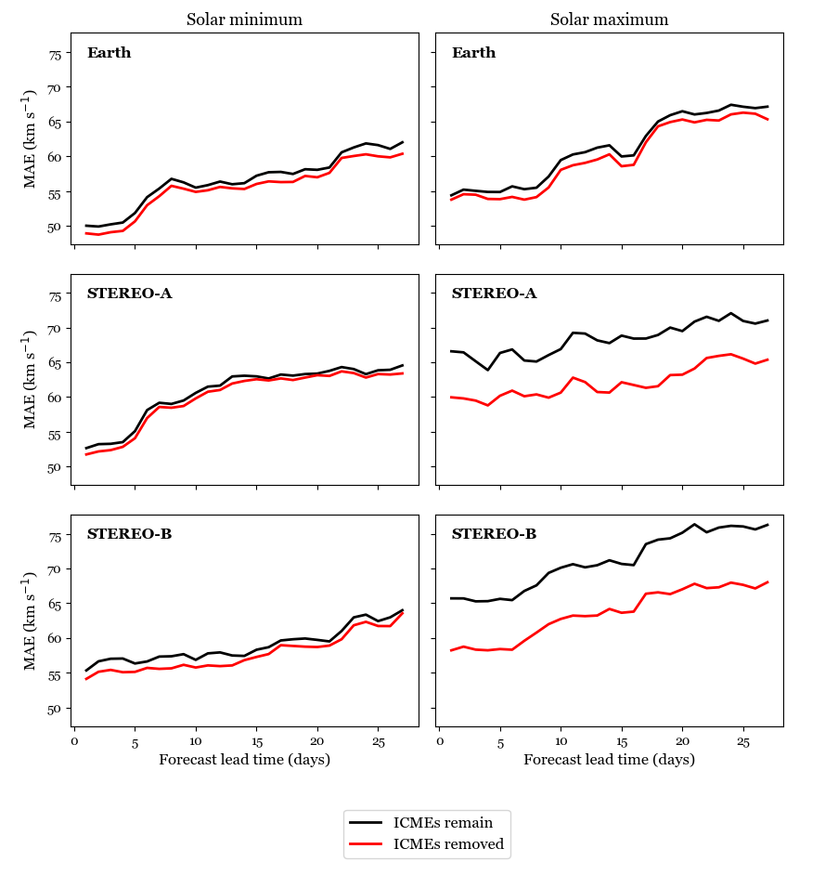
ICME removal
Applying removal over the analysis periods
Larger improvement in solar maximum
More fast ICMEs at STEREO A and B
H. Turner
h.turner3@pgr.reading.ac.uk
RAS
Notes:
Applying the ICME removal to the longer analysis periods, we can see the overall impact. The black line here shows when the ICMEs remain in the forecast and the red line where they are removed from both the input and the verification. We can see that the improvement in the solar minimum period is not significant, but there is greater improvement in the solar maximum period. This is due to a larger number of ICMEs during solar maximum, and the greater improvement at STEREO-A and B is due to a larger number of fast ICMEs being observed during this time. Although the improvements are not great, there is promise that this could be useful for solar wind forecasting. For this to be implementing on a real time basis, an automated system would be required to detect and remove the ICMEs. This is beyond the scope of this study.

Slide 12
Future work
All experiments have been with science-level data
Testing the performance of BRaVDA with real-time data
Required for operational deployment
Initial results are showing that the real-time data does not have much of an impact
H. Turner
h.turner3@pgr.reading.ac.uk
RAS
Notes:
So far, all the experiments I have done with BRaVDA have been using pre-processed, science level data. For the scheme to be deployed operationally, BRaVDA will need to work with real time data from the spacecraft. I am currently looking into this and preliminary results are showing that there is not much impact from using the real time data.

Slide 13
Conclusions
Data assimilation is in early development stages for space weather forecasting
Our implementation has improved solar wind forecasts
Looking at 3 years of forecasts:
Large impact from observation age
Removing ICMEs improves forecast accuracy
Better to assimilate multiple spacecraft observations rather than single spacecraft observations
Moving towards using real-time data
H. Turner
h.turner3@pgr.reading.ac.uk
RAS
Notes:
I have been looking at verifying the performance of the BRaVDA scheme for solar wind forecasting. Looking at two periods of time, one in solar minimum and one in solar maximum, it was found that there is a large impact from observation age when assimilating individual spacecraft, but this is reduced when multiple spacecraft observations are assimilated. It was also found that removing ICMEs produces a small improvement in the forecast mean absolute error, but it is again beneficial to assimilate multiple spacecraft observations to lessen the impact of ICMEs producing false streams in the forecast. I am now moving towards testing the performance of BRaVDA using real time data.

Slide 14
Thank you
h.turner3@pgr.reading.ac.uk

Slide 15
References
ESA, 2022. https://www.esa.int/ESA_Multimedia/Images/2018/01/Space_weather_effects
Lang, M. & Owens, M. J. (2019). A Variational Approach to Data Assimilation in the Solar Wind. Space Weather, 17(1), 59 – 83. DOI: 10.1029/2018SW001857
NASA, 2022. https://www.nasa.gov/mission_pages/sunearth/news/News070712-X1.1flare.html
Owens, M., Lang, M., Barnard, L., Riley, P., Ben-Nun, M., Scott, C. J. & Gonzi, S. (2020). A Computationally Efficient, Time-Dependent Model of the Solar Wind for Use as a Surrogate to Three-Dimensional Numerical Magnetohydrodynamic Simulations. Solar Physics, 295(3). DOI: 10.1007/s11207-020-01605-3
WDC-SILSO, Royal Observatory of Belgium, Brussels. https://wwwbis.sidc.be/silso/home
H. Turner
h.turner3@pgr.reading.ac.uk
RAS

Slide 16
Title
Text
H. Turner
h.turner3@pgr.reading.ac.uk
RAS

